Slide 1


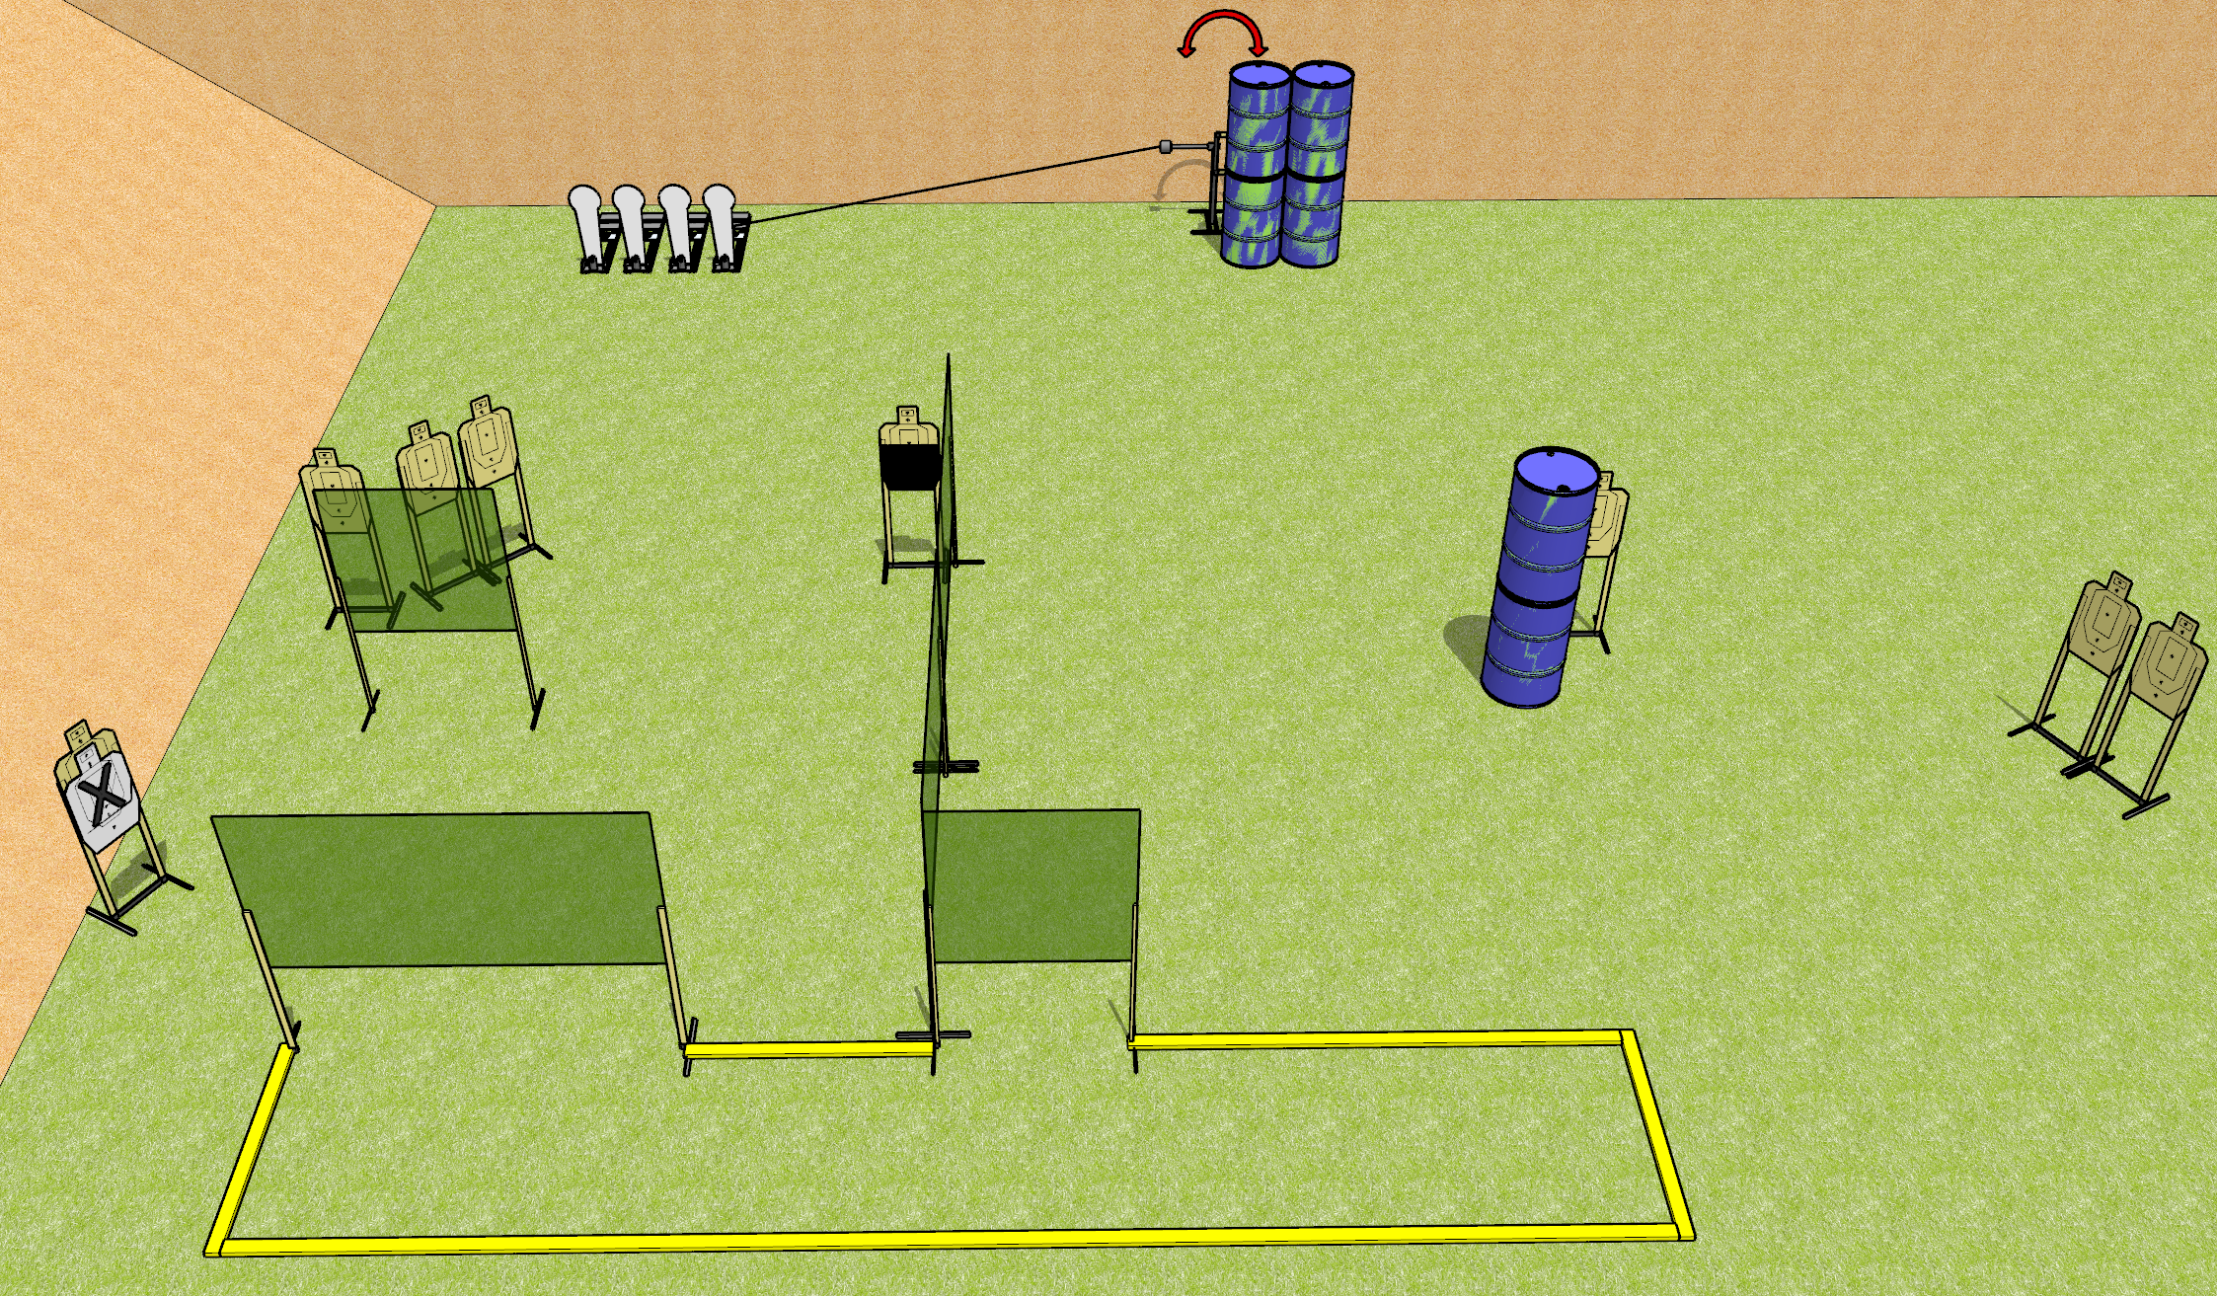
 | Dothan Gun Club – USPSA Match Panic Course Designer : Drew Coleman
Round Count 22 rounds 9 USPSA 4 colt poppers
Equipment List 8 wall feet 1 swinger + activator 1 50%, 1 right diagonal for swinger

Slide 2
Panic
Written Stage Briefing
Panic is a 22 round, 110 point, Comstock course of fire. There are 9 USPSA targets and 4 colt poppers. The best 2 hits on paper will score, and steel must fall to score. The start signal is audible.
The swinger is activated by the rightmost colt popper and remains visible at rest.
Handgun start position is inside the shooting area, wrists below belt. Handgun is loaded and holstered.
PCC start position is inside the shooting area, stock on belt. Loaded carbine is held with both hands, safety on.
On start signal, engage targets as they become available from within the shooting area.

